Slide 1
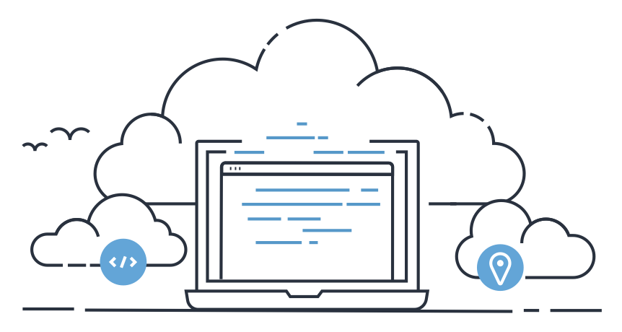
Cloud9 from AWS
https://aws.amazon.com/cloud9/

Slide 2
AWS has supplied a developer IDE and environment that is simple to set-up, is close to free, and avoids all the complexity of installing IDE and versions of various software.
AWS Cloud9 comes with tutorials to use and set-up.
AWS Cloud9 uses IAM to create users of your Cloud9 instances allowing for multiple developers to use the same set-up.
AWS Cloud9 grants a Unix server that you have “sudo” to add items like the “Boost” C library.
Usually Cloud9 is set to shutdown after 30 mins of activity saving money for the “free” version.
As this is an AWS standard instance the underlying compute can be increased or the “hardware” changed. Making it possible to develop of small systems and then change to larger or special “hardware” as needed.

Slide 3
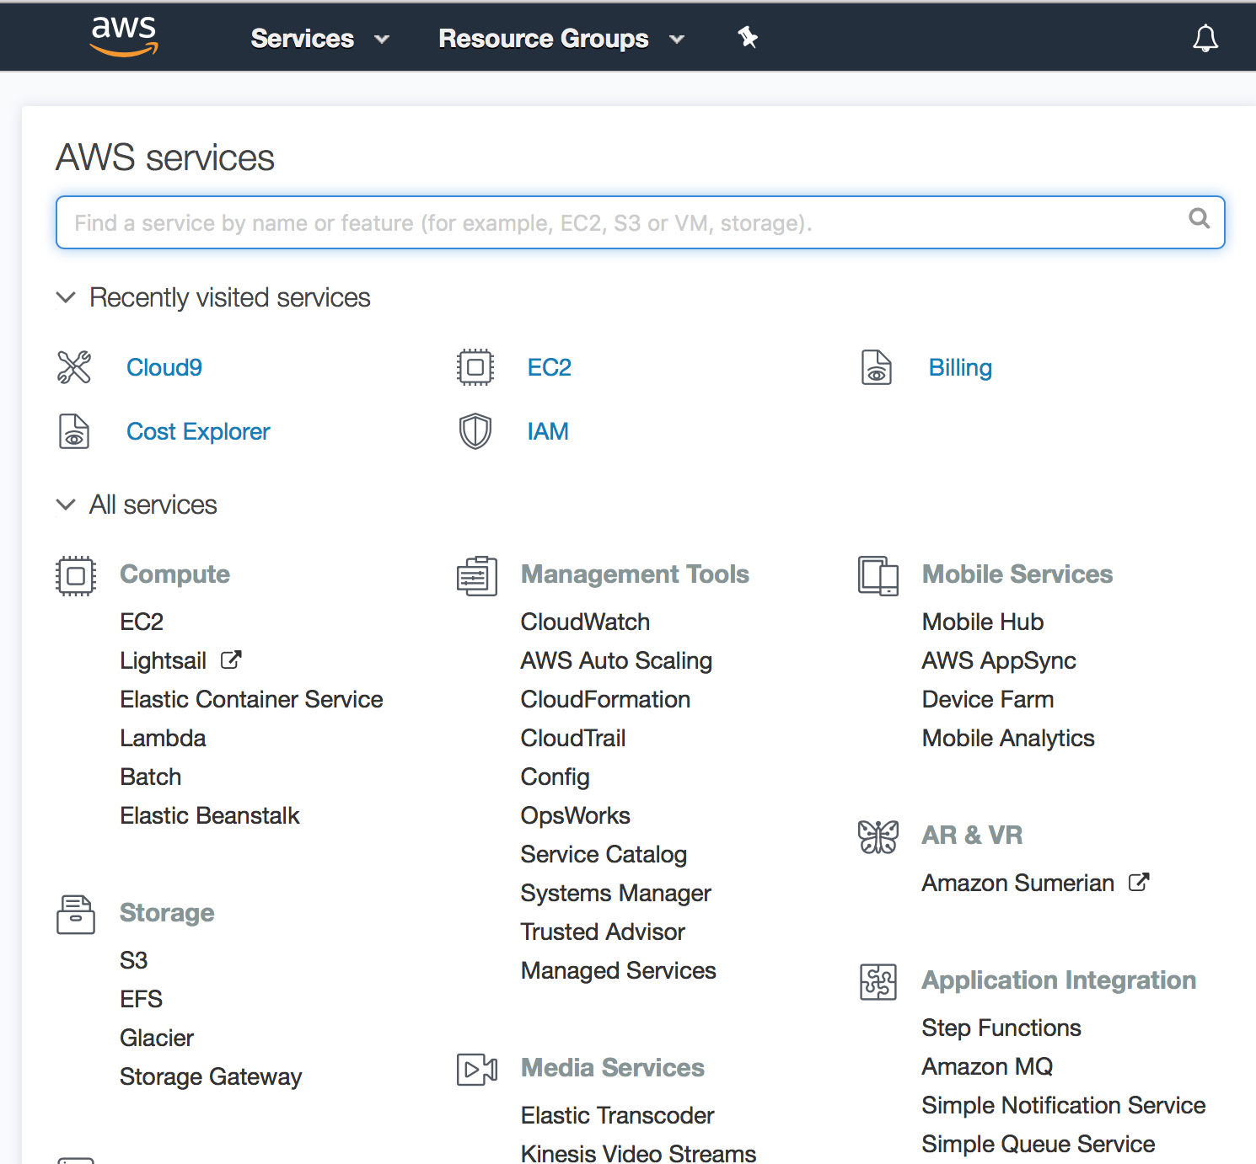
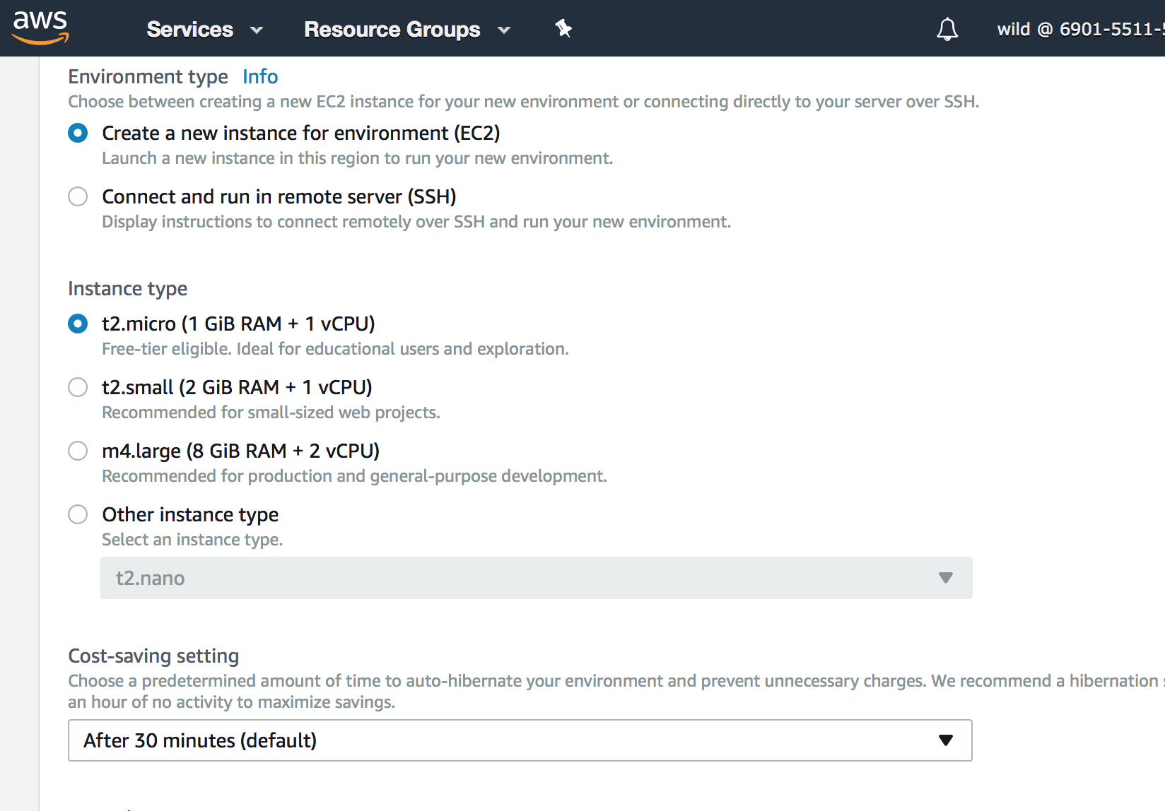
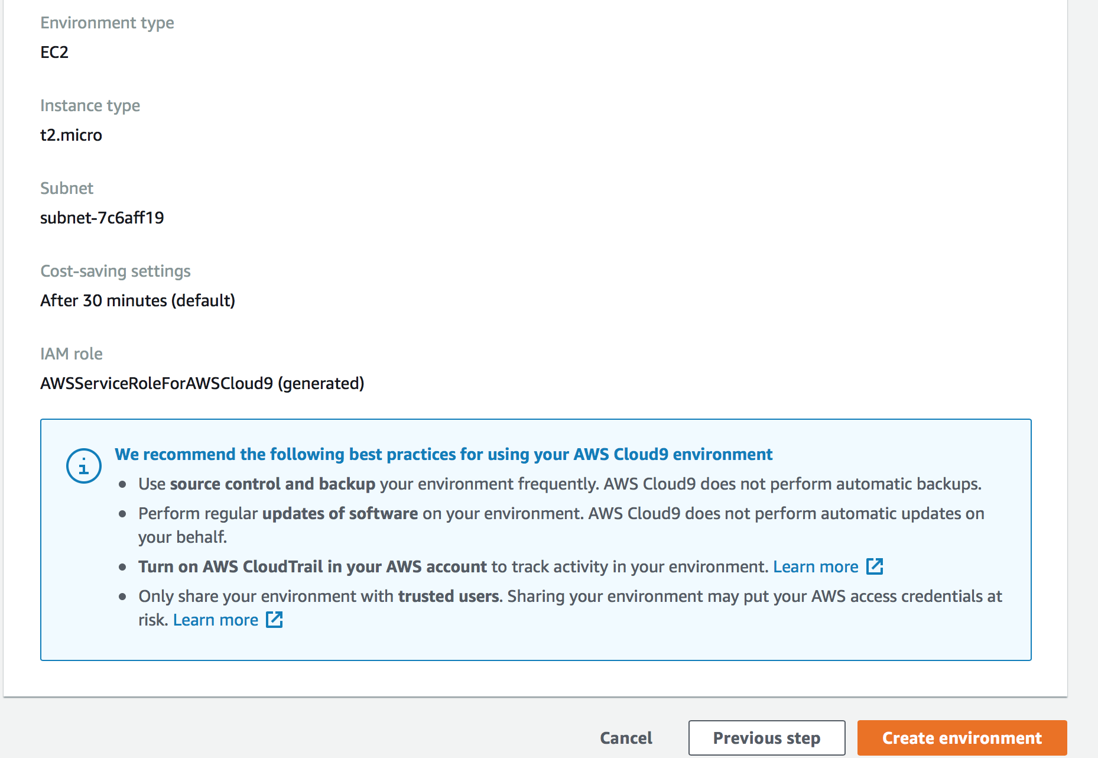

Slide 5
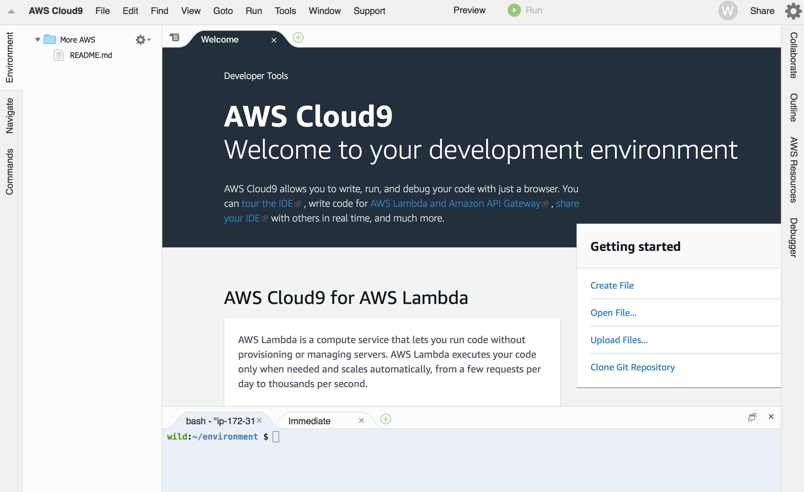

Slide 6
It is “free” but I pay about $1.80 a month for expenses I cannot work out. This includes 6 cents for network traffic. I assume I am cover the cost of the disk storage which is not “free.”
I installed “Boost” and use it for C++ programming.
Ruby, Python all appear to be installed. All the AWS “thingees” are available.
Appears to be Redhat Linux and they patch it for you.
No “projects” in the IDE. Sort of very light Eclipse. Some limited IDE features like variable tracking and various helps. Not as nice at PyCharm but better than many.
Must use IAM and create “users” to use Cloud9. It is “unsafe” to use your “root” account. You can then manage the accounts and use the URL to access you IDE set-ups without risk to hacks to your home “root” AWS account. You can have strong or not security.

Slide 7
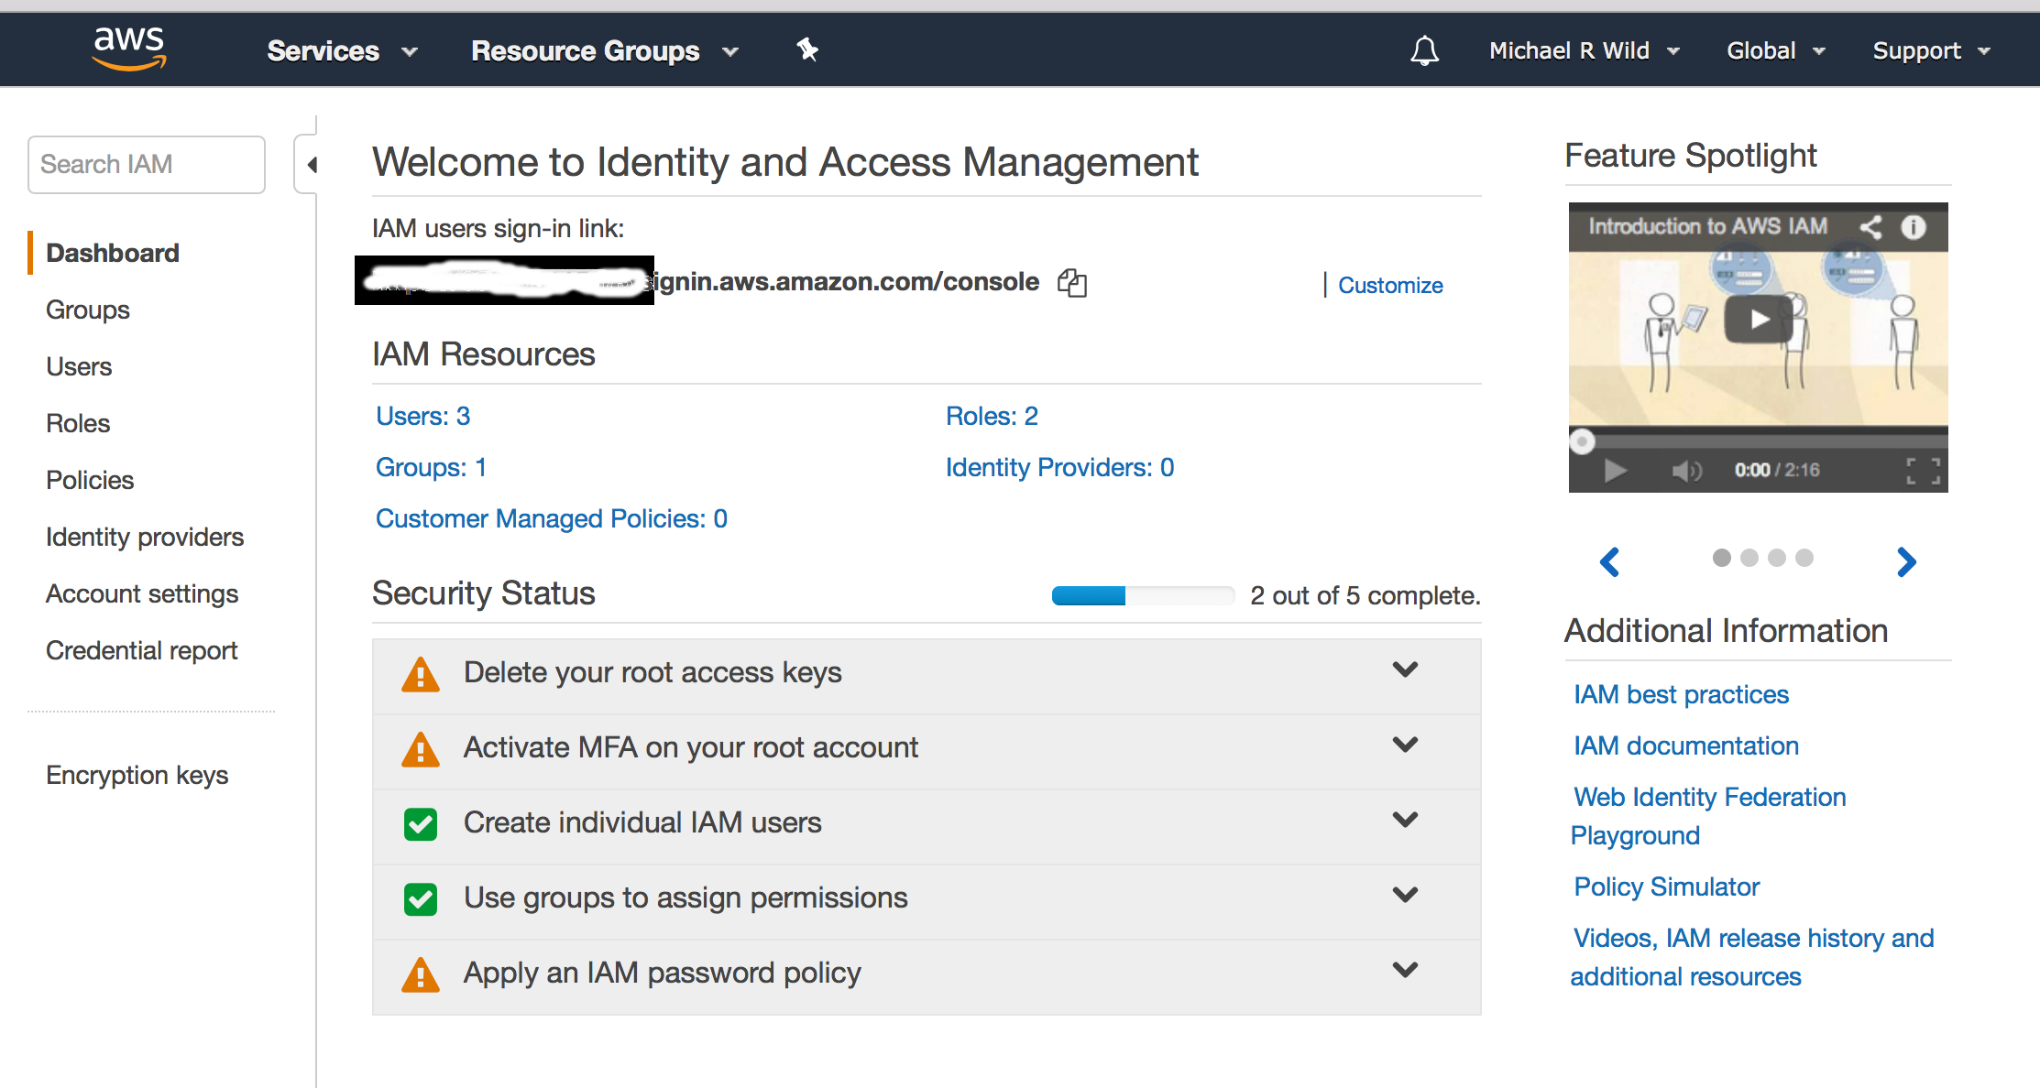
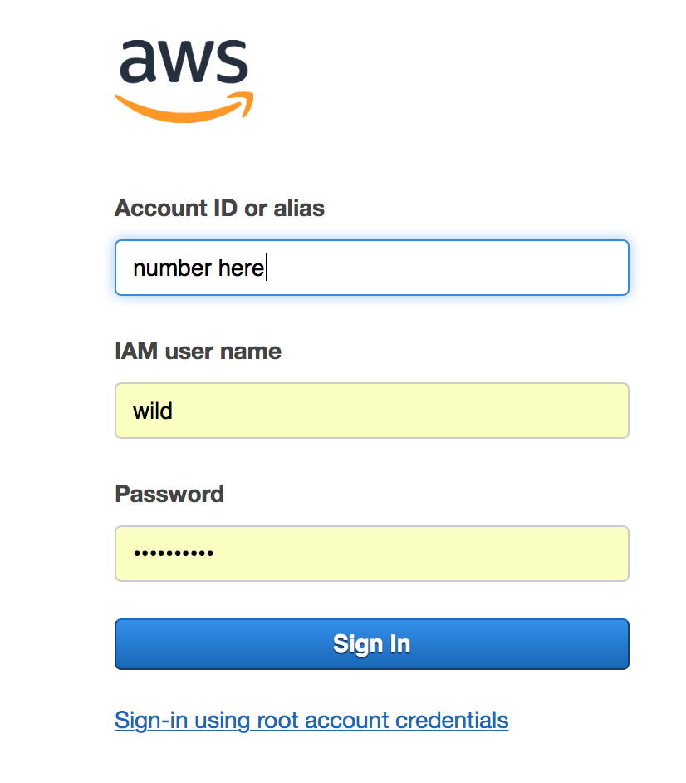
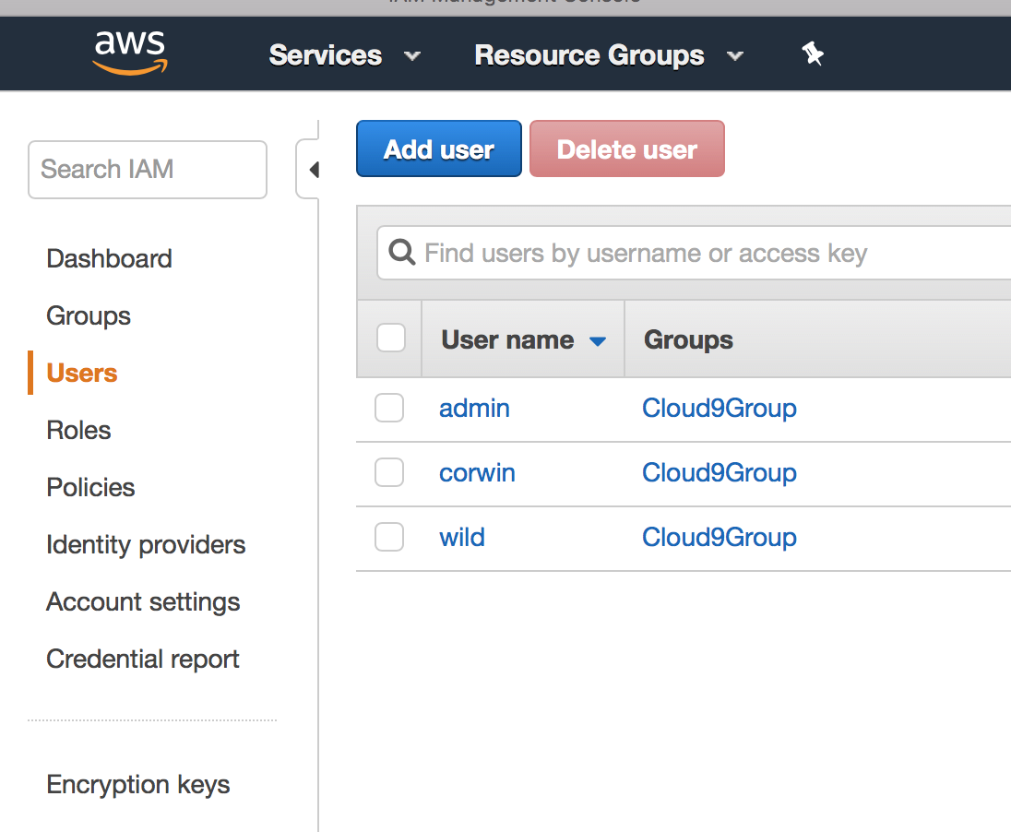

Slide 8
It is “free” but I pay about $1.80 a month for expenses I cannot work out. This includes 6 cents for network traffic. I assume I am cover the cost of the disk storage which is not “free.”
I installed “Boost” and use it for C++ programming.
Ruby, Python all appear to be installed. All the AWS “thingees” are available.
Appears to be Redhat Linux and they patch it for you.
No “projects” in the IDE. Sort of very light Eclipse. Some limited IDE features like variable tracking and various helps. Not as nice at PyCharm but better than many.
Must use IAM and create “users” to use Cloud9. It is “unsafe” to use your “root” account.

Slide 9
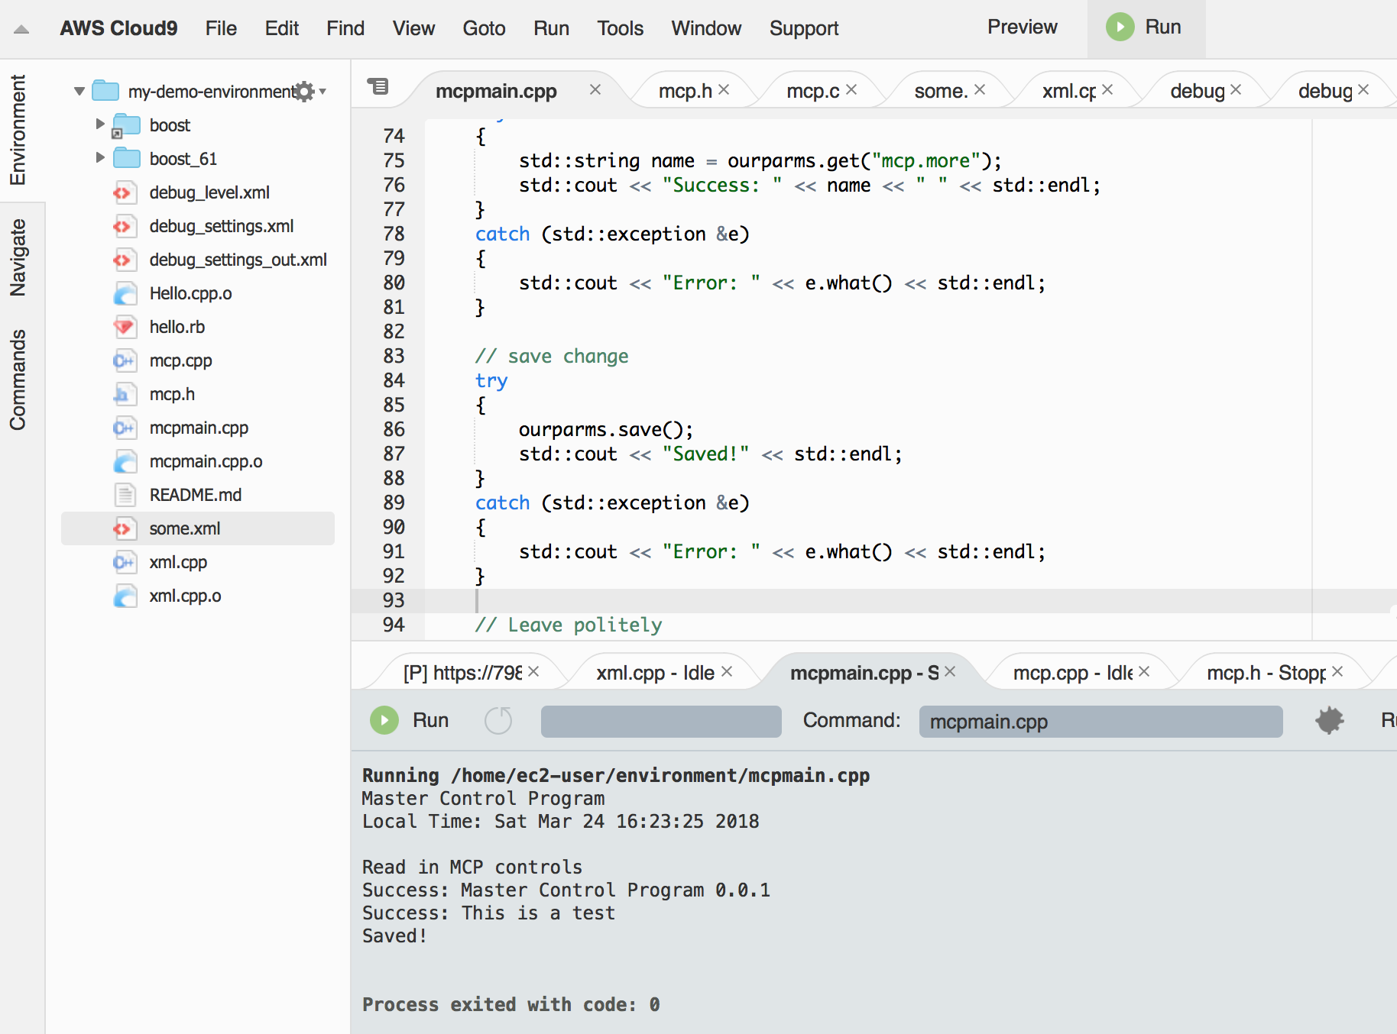

Slide 10
I find it nice to leave a development server in AWS that I can bring up anytime by just going to it on the Internet.
The IDE is good enough.
The access to Linux and “sudo” allows me to make those simple changes I need.
The about $2.00 a month AWS charges is just funny.
Or in other words, it is better than “free.”

Slide 11

Questions?

